Slide 1

Computer Organization & Assembly language(CS-215T)
Lecture by:
Mr. Shakir Karim
Assistant Professor
DoCS&IT, SSUET
Batch 2022F

Slide 2
Topic
Floating-Point Representation, Conversion & Floating-Point Arithmetic
Computer Science & Information Technology Department
Sir Syed University of Engg. & Tech.
Lecture by: Mr. Shakir Karim

Slide 3
Floating-Point Representation
Why the name “Floating-Point”?
Consider the number 32
It is called fixed-point number
That is, the decimal point is fixed at the end
32 => 32.0
Remember Scientific Notation
32 can be written as 3.2 x 10¹
Now, it becomes a Real number (a fraction)
And the decimal point floats w.r.t power of 10
32.0
Or 32.0
= 3.2 x 10¹
= 0.32 x 10²
= 0.032 x 10³
= 32.0 x 10⁰
= 320.0 x 10⁻¹
= 3200.0 x 10⁻²
Computer Science & Information Technology Department
Sir Syed University of Engg. & Tech.
Lecture by: Mr. Shakir Karim

Slide 4
Floating-Point Representation
Why the name “Floating-Point”?
3.2 x 10¹
32.0 x 10¹⁻¹
Moving decimal point to right results in
subtracting 1 from the power of 10
3.2 x 10¹
0.32 x 10¹⁺¹
Moving decimal point to left results in
adding 1 to the power of 10
Floating
Floating
Floating
Floating
Computer Science & Information Technology Department
Sir Syed University of Engg. & Tech.
Lecture by: Mr. Shakir Karim

Slide 5
Floating-Point Representation
So far we know that
there are three elements in floating-point
a number, (Significand/Mantissa)
a base value, (Base)
a power to the base, (Exponent)
±S x B^{± E}
However,
The number is stored in memory with three fields:
Sign: ± (plus or minus)
Significand S
Exponent E
The base B is implicit and need not to be stored
Computer Science & Information Technology Department
Sir Syed University of Engg. & Tech.
Lecture by: Mr. Shakir Karim

Slide 6
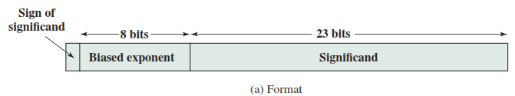
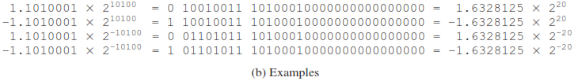
Floating-Point Representation
Typical 32-Bit Floating-Point Format
Computer Science & Information Technology Department
Sir Syed University of Engg. & Tech.
Lecture by: Mr. Shakir Karim

Slide 7
Floating-Point Representation
Sign?
Sign may be +ve or –ve
For +ve, a 0 is placed in MSB
For –ve, a 1 is placed in MSB
Computer Science & Information Technology Department
Sir Syed University of Engg. & Tech.
Lecture by: Mr. Shakir Karim

Slide 8
Floating-Point Representation
Significand (AKA Mantissa)?
There are two types of Significand:
Implicit: radix / decimal point is on the right of the most significant 1
Example: if we have 011001.01₂
then for implicit it has to be 01.100101₂ x 2⁴
i.e., 1.100101₂ x 2⁴
Significand is 100101
Explicit: radix / decimal point is on the left of the most significant 1
Example: if we have 011001.01₂
then for implicit it has to be 0.1100101₂ x 2⁵
Significand is 1100101
Computer Science & Information Technology Department
Sir Syed University of Engg. & Tech.
Lecture by: Mr. Shakir Karim

Slide 9
Floating-Point Representation
IMPORTANT NOTE!
Concept of Normalization:
Representing the significand
as Explicit or Implicit forms is called Normalization.
Computer Science & Information Technology Department
Sir Syed University of Engg. & Tech.
Lecture by: Mr. Shakir Karim

Slide 10
Floating-Point Representation
Biased-Exponent?
Exponent can be + or –
BUT in floating-point;
Exponent is considered without sign
for this reason, the True / Actual Exponent is converted into an exponent without sign
Exponent without sign is called Biased-Exponent
Biased-Exponent = True Exponent + Bias Value
Computer Science & Information Technology Department
Sir Syed University of Engg. & Tech.
Lecture by: Mr. Shakir Karim

Slide 11
Floating-Point Representation
Biased Value?
Bias Value is a fixed value
Typical Bias value is (2^{k-1} – 1)
Here, k = number of bits in binary exponent for a particular floating-point representation
For example;
If k=8, then bias value is 127
Then
Biased-Exponent = True Value + 127
Computer Science & Information Technology Department
Sir Syed University of Engg. & Tech.
Lecture by: Mr. Shakir Karim

Slide 12
Floating-Point’s Benefits
Fixed-Point has limitations
Can not represent very large numbers
Can not represent fractions
Recall Scientific Notation,
We can get around this limitation
Very large number can be represented as
976,000,000,000,000 = 9.67 x 10¹⁴
Fraction values can be represented as
0.0000000000000967 = 9.67 x 10⁻¹⁴
Computer Science & Information Technology Department
Sir Syed University of Engg. & Tech.
Lecture by: Mr. Shakir Karim

Slide 13
IEEE Standard For Floating-Point
Floating-Point representation is defined in
IEEE Standard 754,
adopted in 1985,
revised in 2008
IEEE 754-2008 covers both decimal and binary floating-point representations.
Three basic binary formats have bits lengths of
32 bits with exponent of 8 bits
64 bits with exponent of 11 bits
128 bits with exponent of 15 bits
Computer Science & Information Technology Department
Sir Syed University of Engg. & Tech.
Lecture by: Mr. Shakir Karim

Slide 14
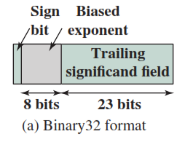
IEEE Standard For
Binary Floating-Point
Three basic binary formats have bits lengths of
32 bits with exponent of 8 bits
Computer Science & Information Technology Department
Sir Syed University of Engg. & Tech.
Lecture by: Mr. Shakir Karim

Slide 15
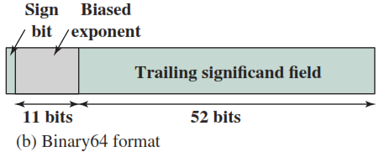
IEEE Standard For
Binary Floating-Point
Three basic binary formats have bits lengths of
64 bits with exponent of 11 bits
Computer Science & Information Technology Department
Sir Syed University of Engg. & Tech.
Lecture by: Mr. Shakir Karim

Slide 16
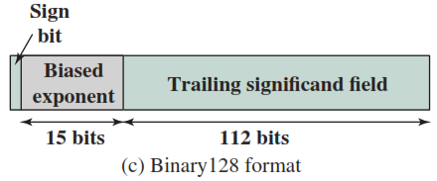
IEEE Standard For
Binary Floating-Point
Three basic binary formats have bits lengths of
128 bits with exponent of 15 bits
Computer Science & Information Technology Department
Sir Syed University of Engg. & Tech.
Lecture by: Mr. Shakir Karim

Slide 17
Floating-Point Representation
Example
Consider, we have to represent 011001.01₂ in 32-bits:
Sign is +ve, therefore MSB is 0
for implicit it has to be 01.100101₂ x 2⁴
i.e., 1.100101₂ x 2⁴
Significand is 100101 and to make it 23bits we have put 17 ‘0s’ afterwards
i.e., Significand is 10010100000000000000000
Biased Exponent = True Exponent + 127
Here, True Exponent is 4
Biased Exponent = 4+ 127 = 131 = 10000011₂
Floating-Point Representation of 011001.01₂:
01000001110010100000000000000000
Computer Science & Information Technology Department
Sir Syed University of Engg. & Tech.
Lecture by: Mr. Shakir Karim

Slide 18
Floating-Point Representation
Example
Consider, we have to represent 011001.01₂ in 32-bits:
Sign is +ve, therefore MSB is 0
for Explicit it has to be 0.1100101₂ x 2⁵
Significand is 100101 and to make it 23bits we have put 16 ‘0s’ afterwards
i.e., Significand is 11001010000000000000000
Biased Exponent = True Exponent + 127
Here, True Exponent is 5
Biased Exponent = 5+ 127 = 132 = 10000100₂
Floating-Point Representation of 011001.01₂:
01000010011001010000000000000000
Computer Science & Information Technology Department
Sir Syed University of Engg. & Tech.
Lecture by: Mr. Shakir Karim

Slide 19
Floating-Point Representation
Practice Problems
Convert the following in 32bits, 64bits, and 128bits IEEE-754 representation:
7.0625₁₀
111.11011₂
00.0001101₂
234.125₁₀
-174.25₁₀
-0.011011₂
-11.03125₁₀
Computer Science & Information Technology Department
Sir Syed University of Engg. & Tech.
Lecture by: Mr. Shakir Karim

Slide 20
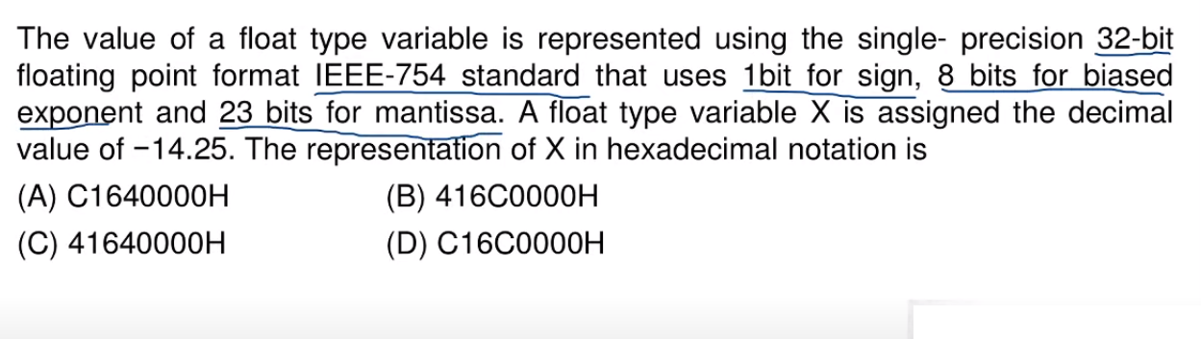
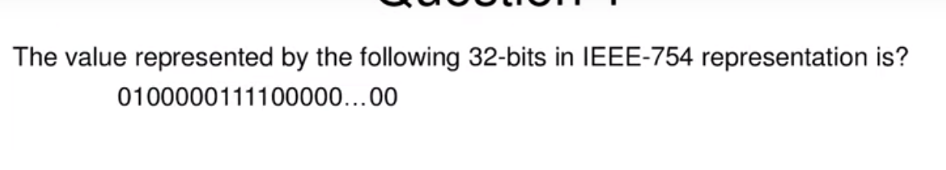
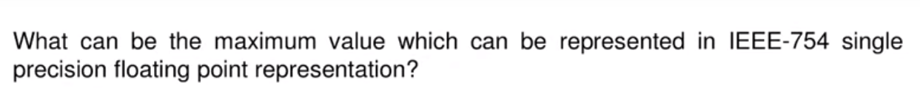
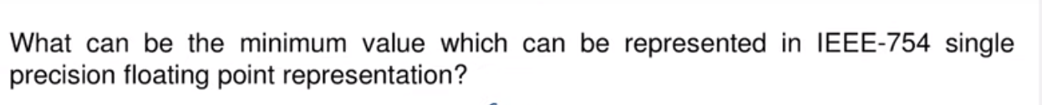
Practice Problems
Computer Science & Information Technology Department
Sir Syed University of Engg. & Tech.
Shared by: Dr. Abdul Hameed Pitafi

Slide 21
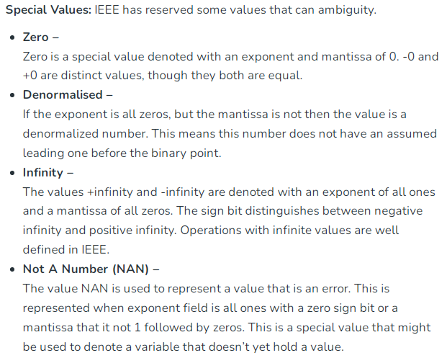
Floating-Point Representation
Computer Science & Information Technology Department
Sir Syed University of Engg. & Tech.
Lecture by: Mr. Shakir Karim

Slide 22
Floating-Point Representation
Computer Science & Information Technology Department
Sir Syed University of Engg. & Tech.
Lecture by: Mr. Shakir Karim

Slide 23
Floating-Point Representation
Summarizing the Special/Reserved Values
Exponent | Significand | Value
0 | 0 | 0
255 | 0 | infinity
0 | not 0 | denormalized
255 | not 0 | NAN
Computer Science & Information Technology Department
Sir Syed University of Engg. & Tech.
Lecture by: Mr. Shakir Karim

Slide 24
Floating-Point Arithmetic
A floating-point operation may produce
Exponent Overflow
A positive exponent exceeds
a maximum possible exponent value.
may be designated as +∞ or -∞
Exponent Underflow
A negative exponent is less than
minimum possible exponent value.
the number is too small
may be reported as 0
Computer Science & Information Technology Department
Sir Syed University of Engg. & Tech.
Lecture by: Mr. Shakir Karim

Slide 25
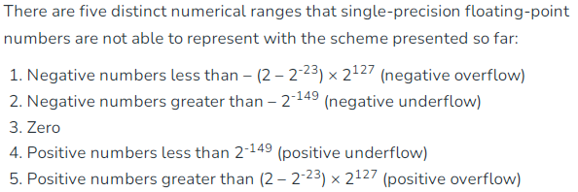
Floating-Point Representation
Computer Science & Information Technology Department
Sir Syed University of Engg. & Tech.
Lecture by: Mr. Shakir Karim

Slide 26

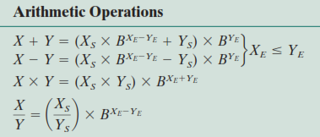
Floating-Point Arithmetic Operations
Computer Science & Information Technology Department
Sir Syed University of Engg. & Tech.
Lecture by: Mr. Shakir Karim

Slide 27
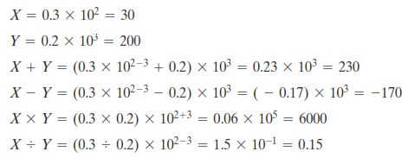
Floating-Point Arithmetic: Examples
Computer Science & Information Technology Department
Sir Syed University of Engg. & Tech.
Lecture by: Mr. Shakir Karim

Slide 28
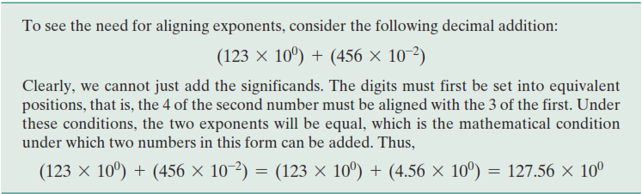
Floating-Point Arithmetic
Addition and Subtraction:
More complex than Multiplication and Division
Due to the need for alignment
Computer Science & Information Technology Department
Sir Syed University of Engg. & Tech.
Lecture by: Mr. Shakir Karim

Slide 29
Floating-Point Arithmetic
Addition and Subtraction:
More complex than Multiplication and Division
Due to the need for alignment
Four basic phases for addition/subtraction algorithm
Check for Zeros
Align the Significands
Add or Subtract the Significands
Normalize the result
Computer Science & Information Technology Department
Sir Syed University of Engg. & Tech.
Lecture by: Mr. Shakir Karim

